Slide 1
Colorado K-12 Funding: Follow the Money
“School Funding in Plain English”
Ben DeGrow
Independence Institute
November 14, 2011

Slide 2
The Money Pot: 2009-10
$8.7 Billion
(Source: Colo Dept of Education)

Slide 3
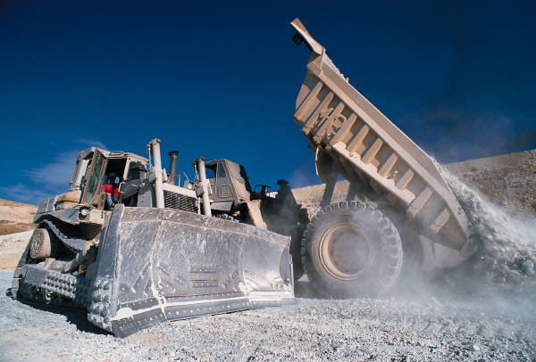
School Finance Act
“Formula” Funding / Per Pupil Revenue
  October 1 Count (5-yr avg = “Phantoms”)
  Formula:
    Size, Cost of living, At-risk students
    Wide range = $6,137 to $13,794 (2011-12)
  Local $ = Foundation / State $ = Backfill (2/3)

Slide 4
School Finance Act: 2009-10

Slide 5
What Else Is There?
State Categorical Programs
  SPED, ELL, Gifted, Transportation, Vocational, Health Services, “Small Attendance Centers”
Local Mill Levy Overrides
Federal Programs (Title I & many more)
Capital Construction
  BEST matching grant program

Slide 6
CO tax funding per student
Fall Count
ADM
ADA

Slide 7

Hidden Costs
Taxpayer-Funded Pension Promises
  “Deferred compensation” …

Slide 8
A Decade of More Spending
Source: CDE, Adjusted for Inflation
1999-2000
2009-2010

Slide 9
Where Does the Money Go?

Slide 10
Instruction, By Location

Slide 11
Instruction, By Object

Slide 12
Support Spending

Slide 13
Resources
Independence Institute
  Citizens’ Budget, K-12 Funding Chapter http://education.i2i.org/2010/12/the-citizens-budget-k-12-funding-issue-brief/
Other
  CDE, http://www.cde.state.co.us/index_finance.htm
  US Dept of Education, http://nces.ed.gov

Slide 14

How Much Reaches the Student?

Slide 15
Fix the System
"...money is used so loosely in public education—in ways that few understand and that lack plausible connections to student learning—that no one can say how much money, if used optimally, would be enough."
- Dr. Paul Hill, Center on Reinventing Public Education

Slide 16

Education Policy Center
http://Education.i2i.org
http://www.SchoolChoiceforKids.org
http://www.EdIsWatching.org
http://www.IndependentTeachers.org

